Slide 1
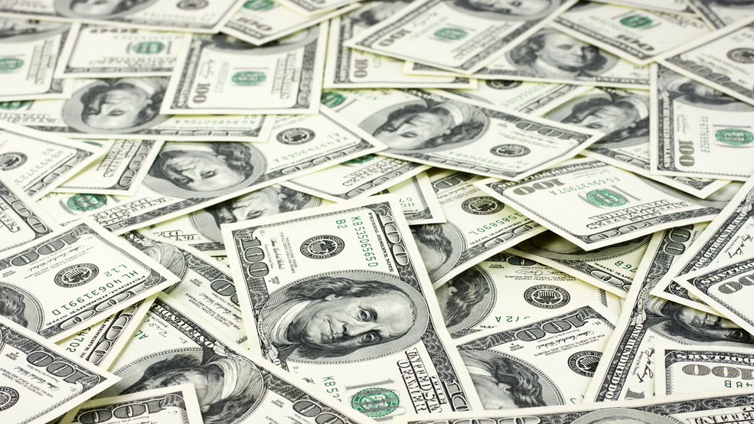
Juvenile care
Event Name : Paathshala
Name : S.Deepan
Topic : Fun-Facts in
Social Studies
Reg No : 19MIS0102
.

Slide 2

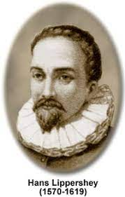
.
Telescope
Galileo Galilei didn't invent the telescope.
The first inventor of the telescope is Hans Lipperhey was a German-Dutch spectacle-maker.
He is commonly associated with the invention of the telescope, because he was the first one who tried to obtain a patent for it

Slide 3
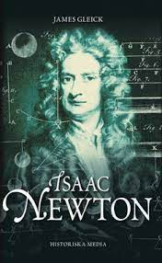
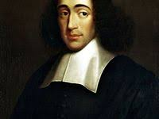
Newton Method
Sir Isaac Newton didnot invented the Newton’s method.
Joseph Raphson pusblished the same method 50 years eariler
Joseph Raphson

Slide 4
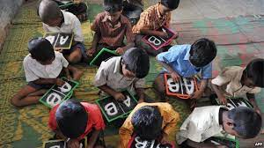
Unknown Fact
India now claims to be the world's second-largest English-speaking country.
The most reliable estimate is around 10% of its population or 125 million people,

Slide 5
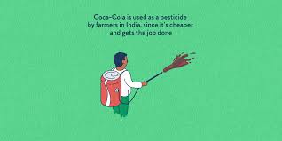
Pepsi and Coco cola
In many villages in india the farmers are using pepsi and coco cola in the fields to kill the insects instead of using the pesticides

Slide 6
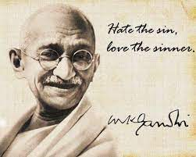
Fact about MK. Gandhi
Mahatma Gandhi was never accorded the 'Father of the Nation' title by Government of India and no rule or ordinance was ever passed in this regard.
This was stated by the Union cultural ministry in a response to an RTI query filed by Hathras resident Gaurav Agarwal

Slide 7
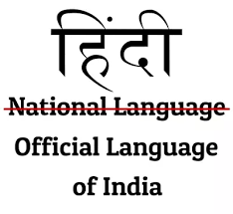
National Language
There is no national language in India. There are various official languages in India at the state/territory level.
However, 343(1) of the Indian constitution specifically mentions that, "The official language of the Union shall be Hindi in Devanagari script.

Slide 8
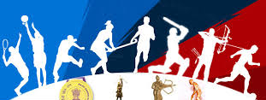
National Sport
No particular sport is recognised as India's national game.
Confirmed by the country's Ministry of Youth Affairs and Sports.

Slide 9
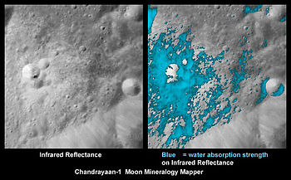
ISRO
ISRO is the only organization to discover water in the moon three months before NASA did.

Slide 10
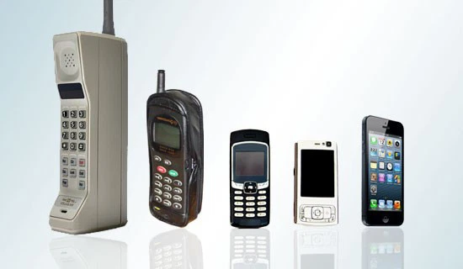
Cell Phone
Motorola is the first company discoverd the cell phone with a cost of $4000 at first time.
But now motoroal is not in the top 10 brands in the world it happend becuase of lack of technology improvement in motoroal

Slide 11
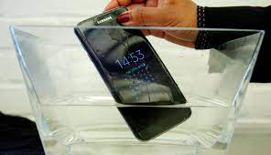
Mobile Phones
More than 90% of mobile phone are water-proof in china. Because they use there mobile phone while bathing.
So these is the reason china is producing more water-proof mobiles.

Slide 12
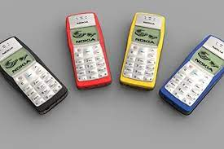
Nokia 1100
Nokia 1100 is world's best selling and most popular mobile ever used. It sold over 25 crores peices around the world
But today’s smart phone did not even get near to the sold ratio of Nokia 1100

Slide 13
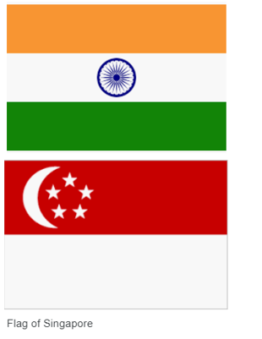
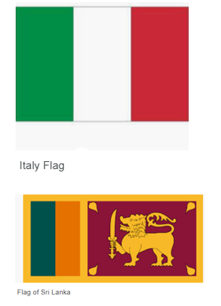
Quiz Time :
.
Find the odd one out from the following flags ?

Slide 14
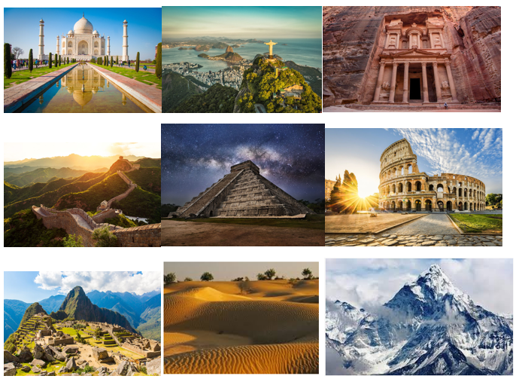
Quiz Time :
what is the difference between them ?
.

Slide 15
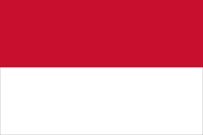
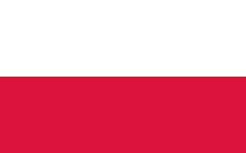
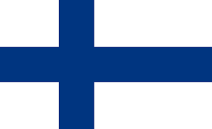
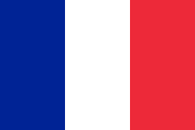
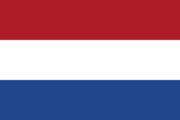
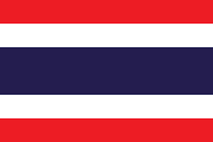
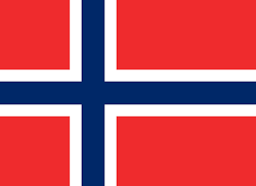
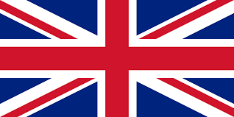
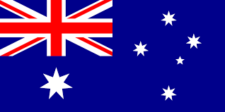
what is the difference between them ?
.
.
Indonesia
Poland
Finland
France
Netherlands
Thailand
U.K
Australia
Norway

Slide 16
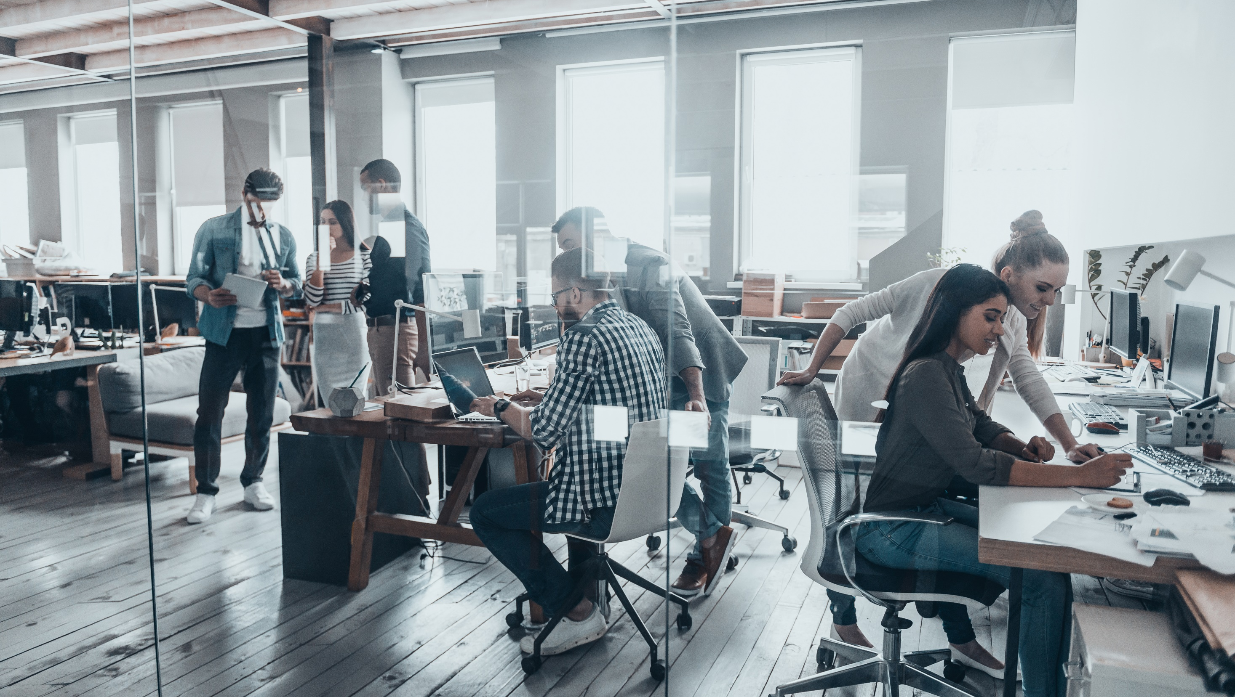
T
.
Answers
Question 1:
Peninsular Regions:
India
Singapore
Italy
SriLanka - Island
Question 2:
Except last two, others are wonders of the world.
The last two are Thar desert and Himalayas respectively.
Question 3 :
Asian: Indonesia, Thailand
Europe: Poland, Finland, France, Netherlands, U.K, Norway
Australia : Itself a continent.

Slide 17
T
.
Thank You

